Slide 1


Learning at Iowa
Using the Three Ms: Practical Tips

Slide 2


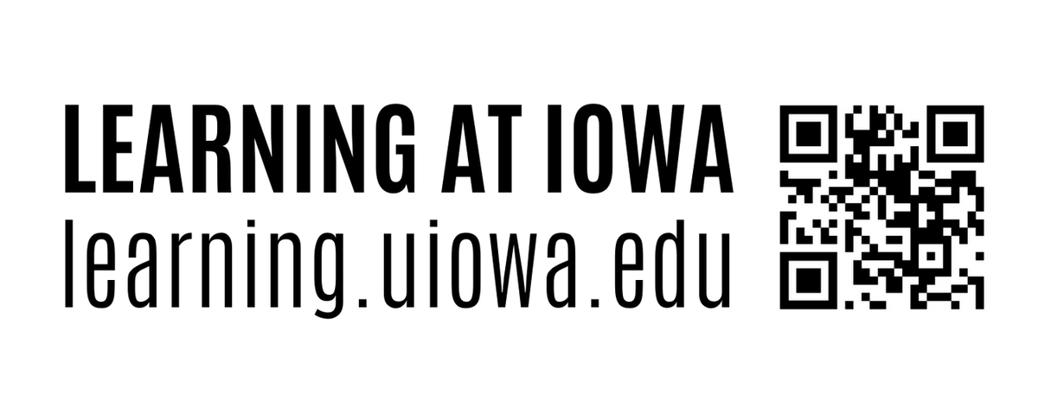
Using the Three Ms: Practical Tips
Table of Contents:
Setting Yourself up for Success: Slides 3-7
Preparing for exams: Slides 8 - 17
Responding to Challenges and Setbacks: Slides 18-22

Slide 3

Using the Three Ms: Practical Tips
Each college semester brings its own ups and downs. Building your growth mindset will remind you that when you put in the time and effort, you are capable of doing hard things!
Think about a time when you faced a challenge in learning a skill that you are now much better at. How did you overcome that challenge or difficulty in order to improve?
What do you anticipate may be a challenge for you this semester?
Now, brainstorm a list of strategies for how to overcome those challenges based on what has worked for you in the past. What are some new strategies you’d like to try this semester?
Remember
that college
is a journey

Slide 4
Using the Three Ms: Practical Tips
When setting goals, focus
on your
own behaviors
What are you doing to maximize your chances of being successful this semester? Instead of focusing on what grades you would like to get, think of concrete actions within your control that will get you there. What are the behaviors and habits that you want to adopt?
Here are some that successful students report doing consistently:
  Showing up to class every day.
  Participating in class regularly.
  Going to office hours when things become challenging.
  Using resources like tutoring and Supplemental Instruction.
  Asking yourself "could I explain this material to someone else?"
  Asking yourself regularly whether you need additional support and reaching out for help when the answer is “yes."

Slide 5
Using the Three Ms: Practical Tips
Behavioral reinforcement means adding something to your environment that makes a certain behavior more likely to happen again in the future. The first step is to identify your behavioral goals. Now, how can you make these activities or habits more appealing? Keep the reinforcers small, sustainable, and as related to the activity as possible. Here are some examples:
  On a day when you meet all your goals, reward yourself with an episode of your favorite show.
  After completing your own deck of flashcards or study guide, take your printed materials and study in a setting that you enjoy, like the Pentacrest or a coffeeshop.
  When studying with a friend, set a timer. Focus without distractions and keep each other accountable. Once the time is up, socialize as a reward!
Create reinforcements in your environment

Slide 6
Using the Three Ms: Practical Tips
How are instructors evaluating your progress in each class?
Knowing the task demands for each of your courses can help you spend more time and effort on what will be most helpful to your learning.
Information on how you’ll be evaluated and what instructors hope you learn from the course can be found in the course syllabus and/or grading rubrics in ICON for specific assignments or papers. Take some time to review those criteria carefully before diving into studying!
Understand how you will
be assessed

Slide 7
Using the Three Ms: Practical Tips
How are instructors evaluating your progress in each class?
Knowing the task demands for each of your courses can help you spend more time and effort on what will be most helpful to your learning.
Information on how you’ll be evaluated and what instructors hope you learn from the course can be found in the course syllabus and/or grading rubrics in ICON for specific assignments or papers. Take some time to review those criteria carefully before diving into studying!
Offload memory demands to free up brain space

Slide 8
Using the Three Ms: Practical Tips
  Our cue to begin studying is often a deadline such as an exam or assignment that is due tomorrow. However, relying on this doesn’t usually leave you enough time to prepare effectively and can become very stressful during busy weeks. To manage your time more strategically, plan your learning in set blocks of time, rather than by which assignment is due next:
  Map out your study schedule for the entire semester in advance. Schedule a daily block of consistent, dedicated time for learning - your "power hour."
  Keep this time reserved for non-distracted work in your classes. Protect this time from demands of work, student organizations, and family obligations.
  Remove or reduce distractions such as your phone, Netflix, noisy settings, etc.
  If it feels challenging to focus for a full hour, start in shorter increments and work up to it.
Plan a regular
Power Hour

Slide 9
Using the Three Ms: Practical Tips
  To make your study sessions as effective as possible, use metacognition to reflect on your own thinking and evaluate your strategies:
    Planning: Before you start your assignments, figure out how long each will take. Designate time for study sessions in your schedule and set goals for each session.
    Monitoring: During your session, ask yourself, is there anything you are confused on? Are you staying focused? Do you need to take advantage of office hours, tutoring, or Supplemental Instruction?
    Evaluating: Don't wait until you get an exam or assignment grade to evaluate whether your current study strategies are working. After each study session, ask yourself: what worked well? What did not work well? What will you do differently next time?
Get more out of your study sessions

Slide 10
Using the Three Ms: Practical Tips
It’s easier to remember something new if you can connect it to something you already know or if you elaborate on the information that you’re learning. To use your lecture and reading notes more effectively, you need to actively review & engage with your notes, rather than just re-read them:
  Generate your own examples and supporting statements.
  Look for the organizing structure of the lecture or reading. Connect ideas and topics presented throughout to try and understand the relationship between them.
  Identify any gaps where your notes don’t make sense. Fill those gaps by going to office hours, tutoring, or Supplemental Instruction, or by asking your study group.
  If reading is assigned before a lecture or discussion, complete it (at least skim or review). Knowing something about the topic of a lecture or discussion gives you some existing knowledge to connect with the new material.
Make your notes meaningful

Slide 11
Using the Three Ms: Practical Tips
Testing yourself on the material actually improves your memory, even if you don't recall the answers right away. By actively trying to remember the information, you strengthen those memories and are less likely to forget the content or skills that you learned. Try one of these strategies before your next exam:
  Create your own flashcards or Quizlet. The most effective way to use them is to take the time to really try to remember, commit to an answer, and then check yourself to see if you are correct.
  Complete any practice tests or review questions the instructor provides. Make sure you answer every question before looking at the answers.
  Cover your notes or your textbook as you read and try to force yourself to recall all of the major topics on the page. Then, try to put them in your own words or explain them to someone else.
Instead of
re-reading,
test yourself

Slide 12
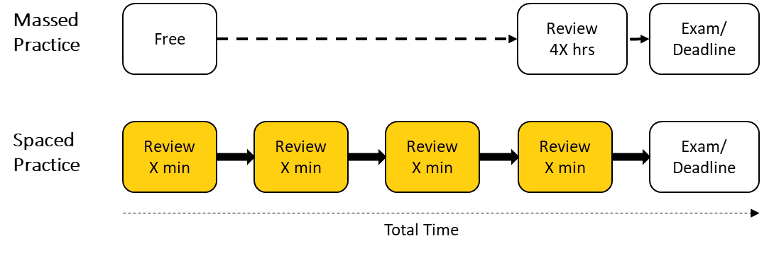
Using the Three Ms: Practical Tips
Don’t try to learn everything, everywhere,
all at once
Spacing out your learning by focusing on a little bit of material at a time is a much more effective use of your study sessions than cramming everything in right before an exam. Cramming is not only very stressful, but it also doesn’t give your memory the chance to work as well. Spaced practice is effective because memories fade quickly. So, each time you re-learn material that has faded, you elaborate and form new connections between ideas, which helps you retain more information and strengthen your memories of the content. Here is an example of a spaced schedule:

Slide 13
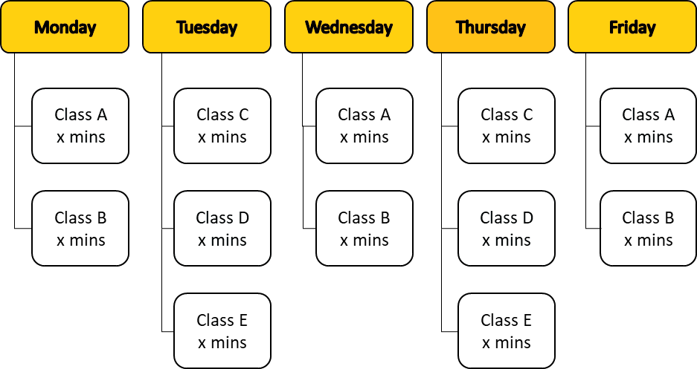
Using the Three Ms: Practical Tips
Rather than spending all of your time on Monday studying for Class A, Tuesday for Class B, etc., interleave your studying so that you are alternating the topics you review within each class or across classes. Here is an example of an interleaved schedule:
Mix it up
by interleaving

Slide 14
Using the Three Ms: Practical Tips
So many things can distract us from studying! Once you recognize the specific ones that disrupt your focus, you can take action to control your environment and reduce distractions:
  Put your phone out of sight and/or turn off notifications.
  Set a time limit to make the work feel less daunting. Start out with 20 minutes of work and then a 5 minute break and work up to longer periods of focus.
  Try studying in a location with lower levels of noise.
  If other people in a study group are pulling your attention, try a session or two on your own to see if you are able to focus better.
  If you enjoy background noise, choose instrumental music without lyrics or listen to white/brown noise.
Identify and control distractions

Slide 15
Using the Three Ms: Practical Tips
So many things can distract us from studying! Once you recognize the specific ones that disrupt your focus, you can take action to control your environment and reduce distractions:
  Put your phone out of sight and/or turn off notifications.
  Set a time limit to make the work feel less daunting. Start out with 20 minutes of work and then a 5 minute break and work up to longer periods of focus.
  Try studying in a location with lower levels of noise.
  If other people in a study group are pulling your attention, try a session or two on your own to see if you are able to focus better.
  If you enjoy background noise, choose instrumental music without lyrics or listen to white/brown noise.
Identify and control distractions

Slide 16
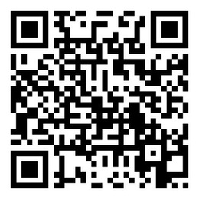
Using the Three Ms: Practical Tips
Being constantly distracted by our phones is a problem almost everyone has experienced! To reclaim your focus and stay on task, try the following:
  Put your phone out of sight or turn off notifications and intentionally use it as a reward once you've finished your power hour or completed a goal.
  As an experiment, track the number of times you look at your phone or get off task each power hour. See if you can reduce this number the next time you are studying!
  We can also become distracted by our phone because we want a break from what we are currently working on. Check out this 2-minute video for tips to help you recognize and break this habit:
Reduce digital distractions

Slide 17
Using the Three Ms: Practical Tips
Consolidate memories with
a good night’s
sleep
Getting regular sleep isn’t just important for your alertness on exam days, but it actually helps you be a more effective learner. Sleep is a key part of consolidating memories so that they can be more easily retrieved later:
  Get in a regular sleep and waking schedule so that your body knows when to expect it.
  Develop a bedtime routine that helps your brain wind down after a long day of studying and working.
  Don't use your bed for studying, because this can make it take longer to fall asleep.
  Reduce your reliance on caffeine and energy drinks to stay alert.

Slide 18
Using the Three Ms: Practical Tips
To keep up your motivation during challenging times of the semester, ask yourself:
  What kind of information do you want to learn?
  What kinds of big questions do you want to know the answers to?
  What type of career are you preparing for?
  How will each course you are taking this semester help you grow closer to those goals?
  How will each course provide an opportunity to grow in ways that are important to you academically, personally, or creatively?
  If you are in a class that you aren’t that passionate about, how can it help you achieve a long-term goal, like fulfilling requirements for your major or learning a second language?
Remind yourself why you came to college in the first place

Slide 19
Using the Three Ms: Practical Tips
Students often experience three major roadblocks to their learning: procrastination, distractions, and burnout.
Anticipating the challenges you might face before you face them can help you problem-solve ahead of time, minimizing the impact these roadblocks have on your learning. The first step to overcoming the challenges is to notice when they are occurring and in what situations they are most likely to occur for you.
What are your most common roadblocks? What strategies and resources can you use to address them?
Problem-solve
in advance

Slide 20
Using the Three Ms: Practical Tips
When the semester gets hard, take time to acknowledge and savor small victories. This will motivate you to stay present and focused as you continue to make progress towards your goals.
Save reminders of these wins for challenging days by keeping a journal, creating an email folder for congratulatory notes, or a paper folder of assignments and projects that you are proud of!
Celebrate small wins

Slide 21
Using the Three Ms: Practical Tips
Remember that while procrastination may work in the short term, it is related to burnout in the long term. Act proactively to combat the natural human temptation to procrastinate:
  When you first get your syllabi, enter deadlines for assignments and exams into your planner.
  Set up reminders leading up to those deadlines so you can space out your learning.
  Develop a system that notifies you of upcoming due dates well in advance.
  Be intentional about setting time aside ahead of the due date to start on assignments or review for an exam.
Proactively combat procrastination

Slide 22
Using the Three Ms: Practical Tips
When you start feeling the initial stages of burnout, try the following:
  Make sure that you are getting enough sleep, eating regularly, and taking breaks to do things not related to your academics.
  Reconnect with your “why.”
  Ask for help from your support team (instructors, advisors, peers, family, etc.).
  Focus on setting reasonable behavioral goals (e.g., spacing study sessions, going to office hours) rather than performance-based goals (e.g., get an A in every class).
  Remind yourself that you are a beginner in your field of study and give yourself permission to ask questions.
Bounce back from burnout

Slide 23
Using the Three Ms: Practical Tips
For more ideas and tips, visit
learning.uiowa.edu/students

